Slide 1
Automated tools
Explore & Output
TRIS
2015.05.10

Slide 2
Brainstorm
TRIS design and realization
TRIS for UPC progress & presentation
Roadmap v0.1
& One more thing

Slide 3
Web UI
Testing
Integration/API Testing
Unit Test
Web UI
API Test (internal & external)
Process-oriented script

Slide 4
Brainstorm
TRIS design and realization
TRIS for UPC progress & presentation
Roadmap v0.1
& One more thing

Slide 5
What TRIS looks like in my mind …
Handle Web UI interaction,
Encapsulate the detailed UI components
Separate test cases and data input
Re-run the failed cases automatically
Continuous Integration
Test report & measurement
Fire all human testers Orz…

Slide 6
Maven + Selenium 2.0 + TestNG + Metrics
Follow-up : integrated with Jenkins and DMP

Slide 7
Selenium 2.0
WebDriver : control the components and handle the page flow
Selenium Grid : concurrent execution of unit tests

Slide 8
Page Object Pattern
Advantage :
Encapsulation – hide the details of
the UI structure
Easy to program for testers
Easy to maintain
Related Reading: Page Object

Slide 9
Brainstorm
TRIS design and realization
TRIS for UPC progress & presentation
Roadmap v0.1
& One more thing

Slide 10
Data impoted from upc_data_template.xlsx
Menu and Module Field resource file
Login TCs
Menu TCs
Service TCs (more)
Completed
Offer and Product TCs
Test Report design
Deployment & Daily build
To Do
Notes:
Completed presentation

Slide 11
Brainstorm
TRIS design and realization
TRIS for UPC progress & presentation
Roadmap v0.1
& One more thing

Slide 12
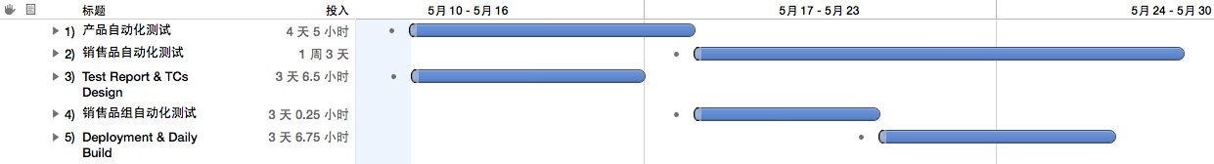
TRIS for upc-crm go alive by the end of May
TRIS preparation for Veris CRM7.x before the first week of June

Slide 13
One more thing
《How Google Tests Software》
In Google Testers included in
SWE：Software Engineer
SET ：Software Engineer in Test
TE：Test Engineer
Notes:
Google的SWE，就是功能开发人员，负责客户使用的功能模块开发，他们编写功能代码及这些功能的单元测试代码。
Google的SET，就是测试开发人员，部分职责是在单元测试方面给予开发人员支持，另一部分职责是为开发人员提供测试框架，以方便他们编写中小型测试，用以进行更多质量相关的测试工作。
Google的TE，就是用户开发人员，负责从用户的角度来思考质量方面各种问题。从开发角度来看，他们编写用户使用场景方面的自动化用例代码；从产品角度看，他们评估整体测试覆盖度，并验证其他工程师角色在测试方面合作的有效性。

